Slide 1

DNR COLLEGE (AUTONOMOUS) BHIMAVARAM
DEPARTMENT OF COMMERCE
3rd B.COM(COMPUTER APPLICATION)
5TH SEMESTER
SUBJECT – TAXTAION
TOPIC- INCOME FROM BUSINESS AND PROFESSION
BY
D.V.MADHAVI

Slide 2

MEANING OF BUSINESS : SEC 2(13)
    Business means any economic activity carried on for earning profits. It Includes,
a)Trade,
b) Commerce
c) Manufacture
d) Any adventure or concern in the nature of trade, commerce or manufacture.

Slide 3
MEANING OF PROFESSION : SEC 2(36)
A profession is an occupation requiring purely intellectual skill or manual skill.
E.g. Lawyer, accountant, engineer, doctor, author.
It also includes vocation.

Slide 4
INCOME FROM BUSINESS & PROFESSION
-:- KEY POINTS -:-
Must be carried on by Assessee.
Must be carried on during the previous year.
Only profit of the previous year are to be taxed.
Income includes negative income i.e. Loss.
A Person Cannot do business with one self. Hence, notional profit is not taxable. If a proprietor withdraws goods casting Rs.50000 for personal use at an agreed value of Rs.60000 then profit of Rs.10000 shall not be taxable.
There is no difference between legal & illegal business for taxation purpose. Even income from illegal business shall be taxable.

Slide 5

Basis of Charge : [ Sec 28 ]
The following income shall be chargeable to income tax under the
head “ Profit & Gains of Business or Profession.
The profit or gains of any business or profession.[Sec 28 (i)]
Income derived by a trade, professional or similar association from specified services performed for its members. [ Sec 28 (ii) ]
The Value of any benefit or perquisite, whether convertible into money or not, arising from business or the exercise of profession. [ Sec 28 (iv) ]
Any interest, Salary, bonus, commission or remuneration due to or received by a partner from a firm. [ Sec 28 (v) ]
Any Sum received for not carrying out any activity in relation to any business or not to share any know-how, patent, copyright, trademark etc. [ Sec 28(va) ]
Income from speculative transaction

Slide 6
SPECIFIC DEDUCTIONS [Sec.30 to Sec 37]
Rent, Rates ,Taxes & Insurance for Building used for the purpose of business. [ Sec 30 ]
Repairs & Insurance of Plant & Machinery , Furniture [ Sec 31 ]
Depreciation of building or plant & machinery.[ Sec 32 ]
Investment Allowance [ Sec 32 AC ]
Tea/Coffee/Rubber Development A/c [ Sec 33 AB ]
Site Restoration Fund [ Sec 33 ABA ]
Reserve for Shipping Business [ Sec 33 AC ]
Scientific Research Expenditure [ Sec 35 ]
Amortisation of telecom licence fees [ Sec 35 ABB ]
Expenditure on eligible projects or scheme [ Sec 35 AC ]
Deduction in respect of exp on specific business [ Sec 35 AD ]
Payment to Association and institution for carrying out rural development program [Sec 35 CCA]
Weighted deduction for expenditure incurred on Agricultural Extension Project [ Sec 35 CCC ]
Weighted deduction for expenditure for skill development [ Sec 35CCD ]
Amortisation of Preliminary Expenses [ Sec 35 D]
Amortisation of Expenditure on development of certain minerals [ Sec 35 E ]

Slide 7

Other deductions
Insurance premium of stock in trade
Bonus or commission to employees
Interest on borrowed capital
Employer’s contribution to provident and other funds
Employer’s contribution to the approved gratuity funds
Bad debts

Slide 8
A. [ SECTION 30 ] : RENT, RATES, TAXES, REPAIRS & INSURANCE OF BUILDINGS USED FOR THE PURPOSE OF THE
BUSINESS
Rent of the premises is allowed as deduction. However, notional rent paid by proprietor is not allowed as deduction. But rent paid by him to its partner for using his premises is allowed as deduction.
Current repairs if the assessee bears the cost of repairs are allowed as deduction. However, Capital repairs incurred by the assessee are never allowed as deduction whether premises is occupied as a tenant or as a owner. Instead the capital repairs incurred shall be deemed to be a building and depreciation shall be claimed.
Any sum on account of Land Revenue, Local Taxes or Municipal Taxes subject to section 43B. as per section 43B deduction shall be allowed only if such sum is actually paid on or before the due date of furnishing or return ; and
Insurance charges against the risk of damage or destruction of
building is allowed as deduction.

Slide 9
B. [ SECTION 31 ] : REPAIRS & INSURANCE OF PLANT, MACHINERY & FURNITURE
repairs to the plant, machinery and furniture is allowed as deduction. However, capital repairs incurred by the assessee are never allowed as deduction whether plant is leased or is purchased. Instead the capital repairs incurred shall be deemed to be an asset eligible for depreciation.
Premium paid for insurance against the risk of damage or destruction of plant, machinery or furniture is allowed as deduction.

Slide 10

C. [ SECTION 32 ] : DEPRECIATION
In respect of depreciation of-
  buildings, machinery, plant or furniture, being tangible assets;
  know-how, patents, copyrights, trade marks, licenses, franchises or any other business or commercial rights of similar nature, being intangible assets acquired on or after the 1st day of April, 1998,

Slide 11
D. [ SECTION 36(1)(i) ] : INSURANCE OF STOCK
The amount of any Insurance premium paid in respect of insurance against risk of damage or destruction of stocks or stores used for the purposes of the business is allowed as discount.

Slide 12
It is allowed as deduction if following conditions are satisfied :
E. [ SECTION 36(1)(ib) ] : INSURANCE PREMIUM ON THE HEALTH OF EMPLOYEES
a. The Premium is paid by Cheque by the employer; and
b. Premium is paid under the Scheme framed in this behalf by the General Insurance Corporation of India and approved by the Central Government.

Slide 13
F. [ SECTION 36(1)(ii) ] : BONUS OR COMMISSION PAID TO EMPLOYEES
Bonus or Commission paid to an employee is allowable as
deduction subject to certain conditions:
  Admissible only if not payable as profit or dividend : One of the conditions is that the amount payable to employees as Bonus or Commission should not otherwise have been payable to them as profit or dividend. This is provided to check an employer from avoiding tax by distributing his / its profit by way of bonus among the member employees of his/its concern, instead of distributing the sum as dividend or profits.
  Deductible on payment basis : Bonus or Commission is allowed as deduction only where payment is made during the previous year or on or before the due date of furnishing return of income u/s 139.

Slide 14

G. [ SECTION 36(1)(iii) ] : INTEREST PAID ON BORROWED CAPITAL FOR THE PURPOSE OF BUSINESS OR PROFESSION
(i) CONDITIONS
As per Supreme Court judgement :
The sum of money should be borrowed from another assessee.
The loan may be borrowed from any Bank, Financial Institution, Govt. , Public, friends or
relatives.
Loan may be in the form of debentures or deposits etc.
Interest on capital or loan to proprietor is not allowed as deduction since the loan is not borrowed from another person.
Interest paid by firm to its partner on their capital contribution is allowed as deduction.
Such borrowed money should be used for the purpose of business or profession. But where the amount of loan is used for personal purpose it is not allowed as deduction.
E.g. the loan is borrowed for the payment of income tax not allowed as deduction. However, loan is borrowed for payment of dividend or sales tax is allowed as deduction.
The Interest has accrued during the relevant previous year. However, where the interest falls u/s 43B, i.e. where interest is payable to banks or financial institutions, then to claim deduction such interest should actually be paid on or before the due date of furnishing of return.

Slide 15
INTEREST ON BORROWINGS FOR ACQUIRING NEW ASSETS
ii) PROVISON 1 TO 36 (1)(iii). Interest accrued before the commencement of business not allowed as deduction but has to be capitalized and added to the actual cost of fixed assets acquired out of borrowed capital.
Interest accrued after the commencement of business but before the asset is put to use is not allowed as deduction but has to be capitalized and added to the actual cost of the fixed assets acquired out of borrowed capital.
Interest accrued after the asset is put to use is allowed as deduction u/s 36(1)(iii)
OTHER POINTS
Where interest is paid outside India without deduction of tax at source is not allowed as deduction.
Income tax department cannot question the need for borrowing and the rate of interest.
Interest other than interest on borrowing is allowed as deduction u/s 37 and not under this clause. E.g. Interest on late payment of sales tax etc.

Slide 16

H. [ SECTION 36(1)(iv) ] : EMPLOYER’S CONTRIBUTION TOWARDS RECOGNIZED PROVIDENT FUND OR AN
APPROVED SUPER ANNUATION FUND.
Employer’s contribution paid towards recognized provident fund or an approved superannuation fund is allowed as deduction subject to Sec. 43B. However, contribution to Non-Statutory Fund or Unapproved Fund is not allowed ad deduction. In case of contribution towards superannuation fund is allowed as deduction u/s 37.

Slide 17
[ SECTION 36(1)(v) ] : EMPLOYER’S CONTRIBUTION PAID TOWARDS AN APPROVED GRATUITY FUND
Any sum paid by the assessee as an employer by way of contribution towards an approved gratuity fund created by him for the exclusive benefit of his employees under an irrevocable trust is allowed as deduction subject to section 43B.

Slide 18

J. [ SECTION 36(1)(va) ] : EMPLOYEE’S CONTRIBUTION TOWARDS STAFF WELFARE SCHEME.
Any sum received by the assessee from his employees as
contributions :
to any provident fund or
superannuation fund or
any fund set up under the provisions of the Employee’s State Insurance Act, or
any other fund for the welfare of such employee
is treated as income in the hands of assessee unless such
employee’s contribution is credited in employee’s account on or before the ‘due date’ specified under the provisions of any law or terms of contract of service or otherwise.
However employer’s contribution (not employee’s contribution) towards such fund is allowed as deduction subject to section 43B
i.e. such contribution is paid on or before the due date of furnishing return.

Slide 19
K. [ SECTION 36(1) (vii) ] : BAD DEBTS
(i) Conditions
A deduction will be allowed in respect of any Bad Debt which is written off as irrecoverable in the account of the assessee for the previous year subject to the conditions specified in Sec. 36(2) as follows :
1. No such deduction shall be allowed unless such debt or part thereof has been taken into account in computing the income of the assessee of the
previous year in which the amount of such debt or part thereof is written off or of an earlier previous year, or
e.g. Credit Sale made Rs.50,000 not realized. Rs.50,000 shall be allowed
as deduction since sale is treated as income.Advance made for purchase of stocks. Advance forfeited not allowed as deduction since advance money not a part of income.
Represents money lent in the ordinary course of the business of banking or money lending which is carried on by the assesses
(ii) Notes
1.
2.
•
•
Bad Debt can be claimed as deduction by the successor of the business However Provision for Bad Debt is not allowed deduction.

Slide 20
(iii) Section 41(4). Recovery of Bad Debt
Where a deduction has been allowed in respect of a bad debt or part of debt, then, if the amount subsequently recovered on any such debt or part is greater than the difference between the debt or part of debt and the amount so allowed, the excess shall be deemed to be profits and gains of business or profession, and accordingly chargeable to income-tax as the income of the previous year in which it is recovered, whether the business or profession in respect of which the deduction has been allowed is in existence in that year or not.

Slide 21
L. [ SECTION 36(1)(ix)] : FAMILY PLANNING EXPENDITURE INCURRED BY COMPANY
Deduction in respect of Revenue Expenditure for promoting family planning amongst its employees is allowed as
deduction and in case of Capital expenditure , 1/5 of expenditure incurred is allowed as deduction in 5 equal installment.

Slide 22
N. [ SECTION 37 ] : GENERAL DEDUCTION
(i) Conditions
This is a residuary section. Hence this section covers only those items of business expenditure which are not covered under section 30 to 36. the deductions u/s 37 is allowed if expenditure satisfies all the three conditions mentioned below :
Expenditure is incurred wholly and exclusively for the purpose of the business.
The word ‘wholly’ refers to the quantum of expenditure and the word
‘exclusively’ refers to the motive, object or purpose of the expenditure. The expression ‘ for the purpose of the business’ is essentially wider than the expression ‘ for the purpose of earning profits’.
Such Expenditure is not in the nature of personal expenditure.
Such expenditure is not of Capital in nature i.e. expenses should be of revenue in nature. The word “Capital” connotes permanency and “Capital
Expenditure” is , therefore, closely akin to the concept of securing something,
tangible or intangible property , or corporeal or incorporeal right, so that they could be of a lasting or enduring benefit to the enterprise in issue. Revenue expenditure, on the other hand, is operational in its perspective and solely intended for the furtherance of the enterprise.

Slide 23
Following Expenditures were held to be incurred wholly and exclusively for the purpose of the Business
Official or Administrative Expenses
Audit or Legal Fees
Advertising Expenses, Traveling or Conveyance Expenses
Entertainment Expenses
Interest paid for overdraft facility
Remuneration payable to employees or other expenses incurred for the benefit of employees.
Diwali Expenses
Interest paid on payment of dividend is allowed as deduction. (However interest on payment of income tax or other personal liability is not allowed as deduction).

Slide 24
Following Expenditure were held to be Personal Expenses
Drawing by the owner for personal use.
Interest on own capital in case of proprietorship concern.
Remuneration paid to owner of the business in case of Proprietary concern.
Donation u/s 80G or any other similar donations not connected with business of the assessee. (However business donation is allowed as deduction)

Slide 25
Others ( not allowed as deduction)
Any Provisions or Reserves for contingencies, anticipated loss, dividend, sales tax, custom duty, excise, gratuity, bonus etc. (However, actual payment of sales tax, excise duty or custom duty is allowed as deduction subject to Sec. 43B.)
Note : However under section 40A(7) provision made for gratuity which becomes payable in the PY is allowed as deduction.
Notional Expenses, i.e. Rent Paid for own building etc.

Slide 26
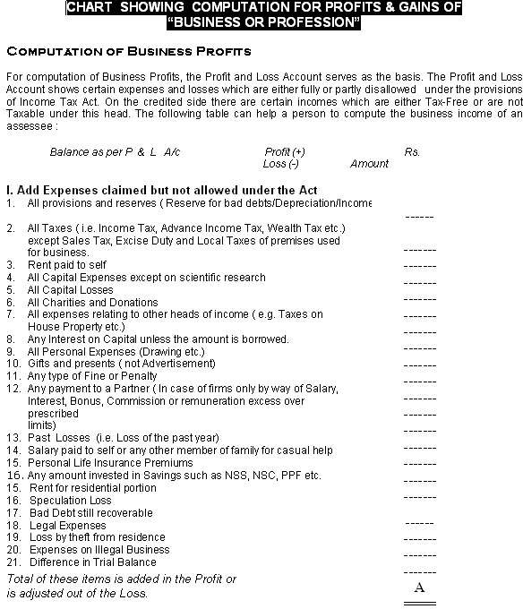

Slide 27
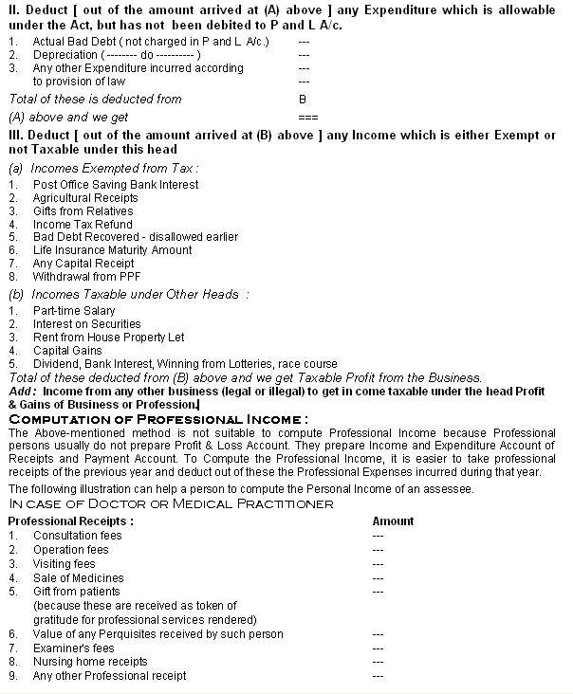

Slide 28
