Slide 1

DANTULARI NARAYANA RAJA COLLEGE
(AUTONOMUS)
Department of Biochemistry
Conducted BY
SIR.RAMESH (HOD)
M.SC M.PHIL

Slide 2
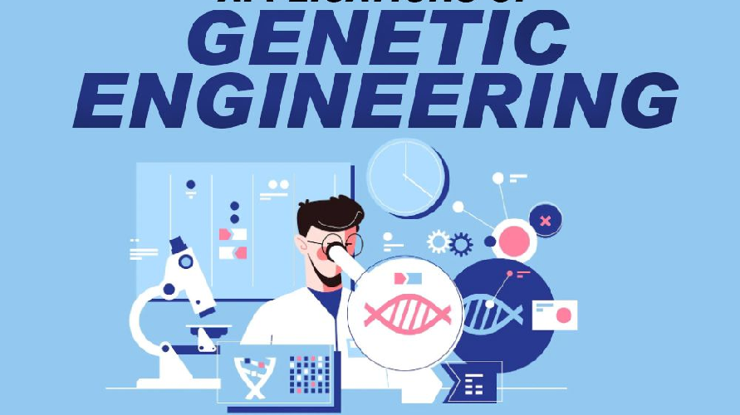

Slide 3


Genetic Engineering and the Environment
A powerful tool with potential to address environmental challenges.

Slide 4
The Role of Genetic Engineering in Environmental Conservation
1
Biodiversity
2
Pollution
Preserving endangered species.
Detoxifying contaminated soil.
3
Climate Change
4
Conservation
Developing crops resilient to drought.
Restoring degraded ecosystems.

Slide 5
Genetically Modified Organisms (GMOs) and their Impact on Ecosystems
Benefits
Concerns
Research
Increased crop yield and nutritional value.
Potential for unintended consequences.
Ongoing studies to assess risks and benefits.
Reduced pesticide use.
Gene flow to wild populations.
Enhanced resistance to pests and diseases.
Impact on biodiversity.

Slide 6
Ethical Considerations in Genetic Engineering for Environmental Purposes
Bioethics
Equity
Respect for nature and ecological integrity.
Fair distribution of benefits and risks.
Transparency
Regulation
Open communication and public engagement.
Establishing guidelines for responsible use.

Slide 7




Advancements in Genetic Engineering for Renewable Energy Solutions
Biofuel
Solar Energy
Bioplastics
Hydrogen Production
Enhanced algae production.
Increased efficiency of photosynthesis.
Developing biodegradable plastics.
Engineering microbes for efficient hydrogen production.

Slide 8




Challenges and Limitations of Genetic Engineering in Environmental Protection
Complexity
Unforeseen Impacts
Cost
Public Perception
Developing and implementing genetic solutions.
Understanding complex ecological interactions.
Potential for unintended consequences.
Addressing concerns and skepticism.

Slide 9
The Future of Genetic Engineering and its Potential for Environmental Sustainability
Precision Engineering
1
Targeted gene editing for specific environmental goals.
2
Synthetic Biology
Creating novel organisms for environmental remediation.
Bioremediation
3
Using engineered microbes to clean up pollution.
4
Sustainable Agriculture
Developing crops that require less water and fertilizer.

Slide 10


